Slide 1
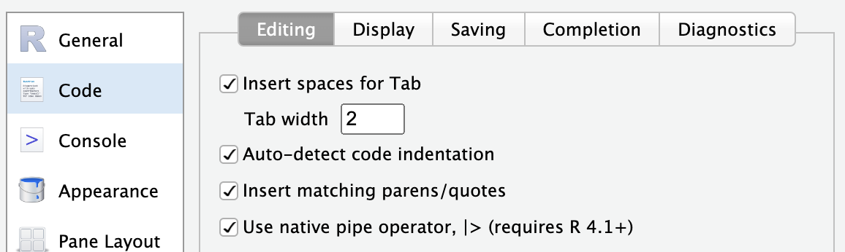

Slide 2
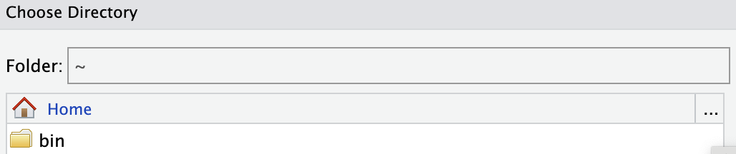

Slide 3
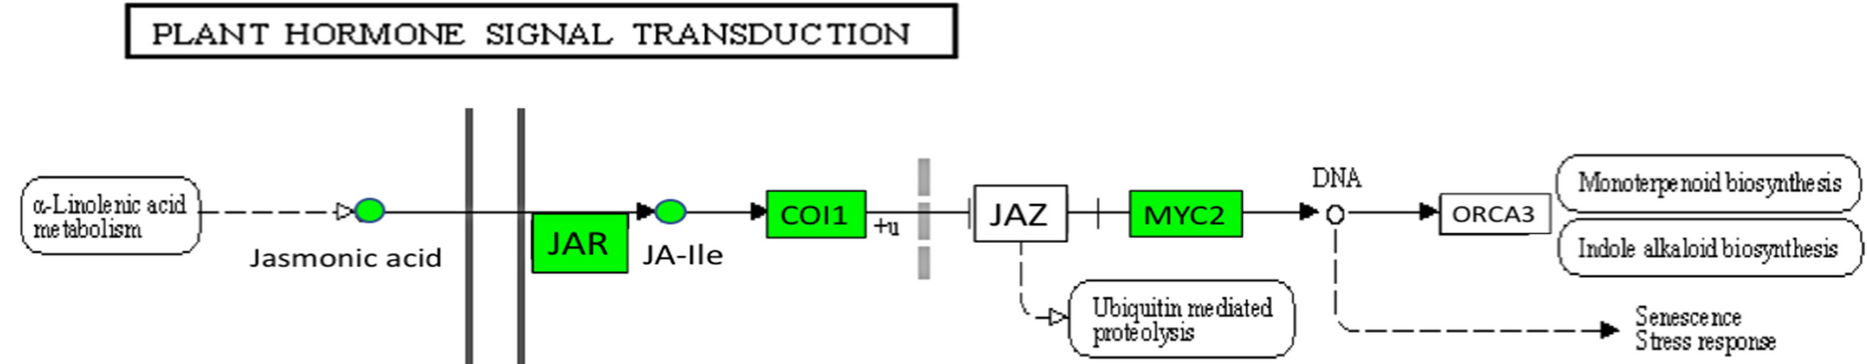

Slide 4
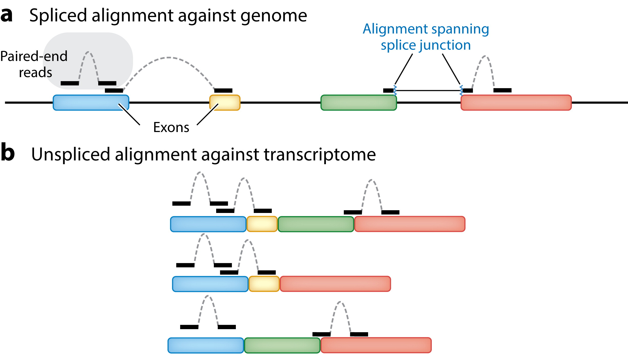

Slide 6
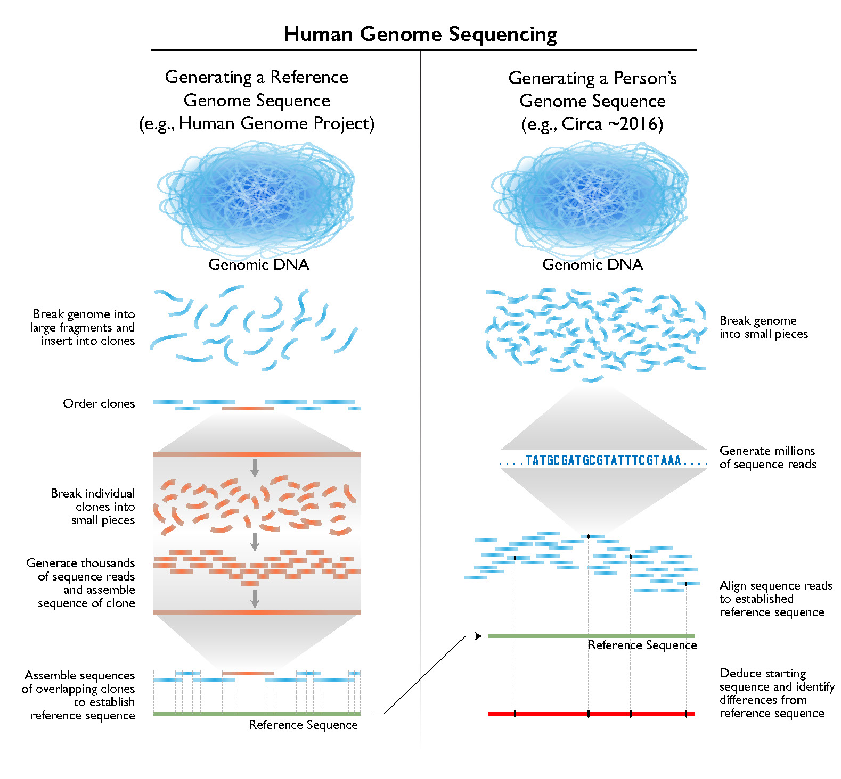

Slide 7
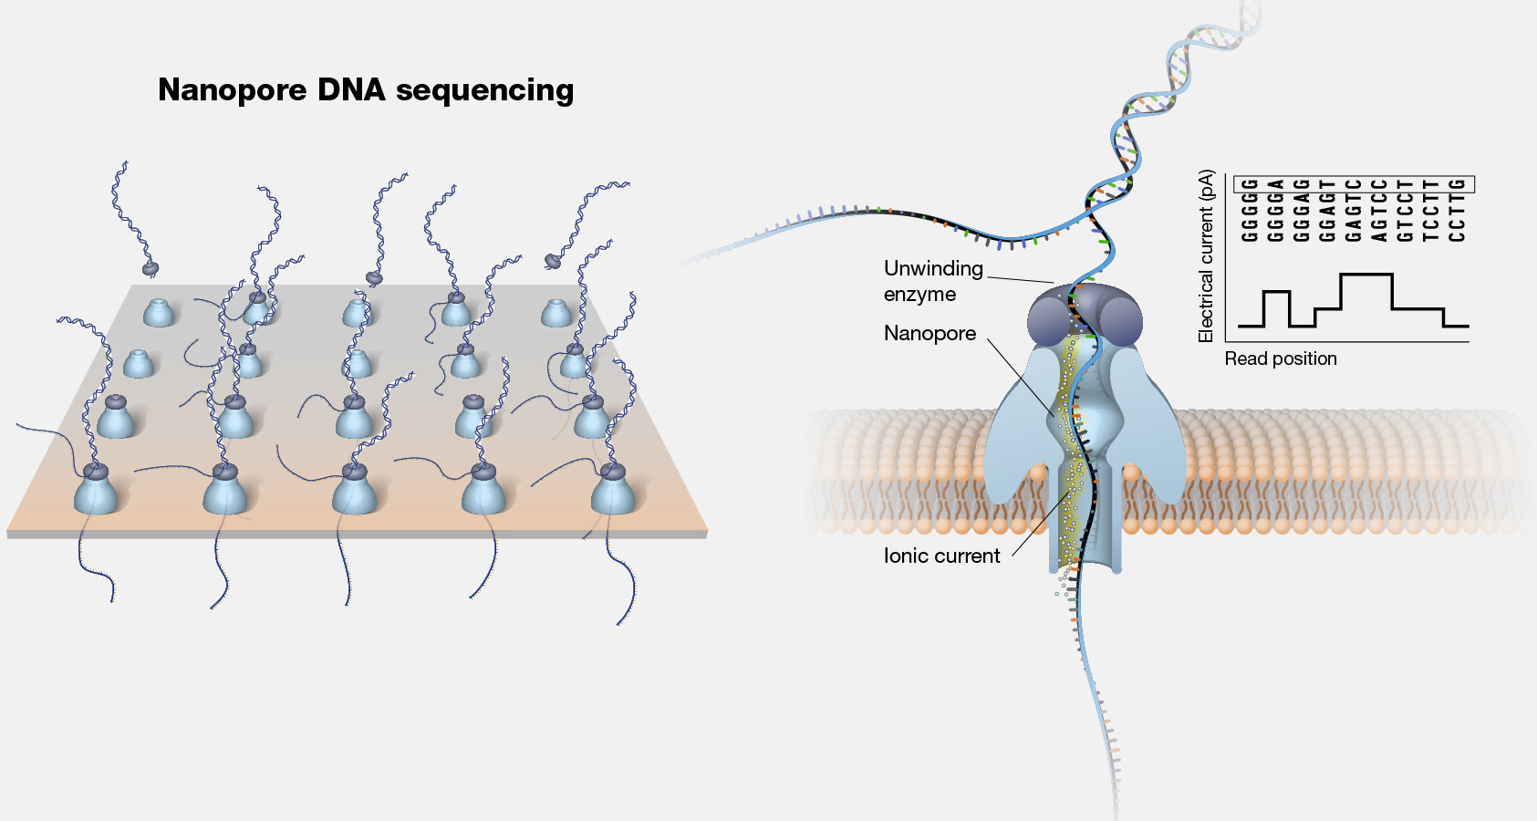

Slide 8
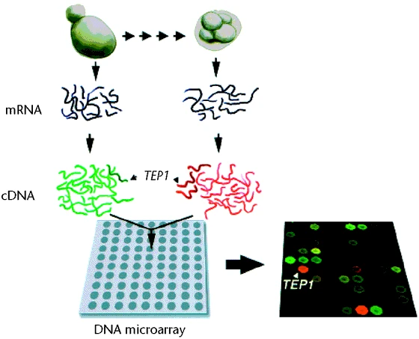

Slide 9
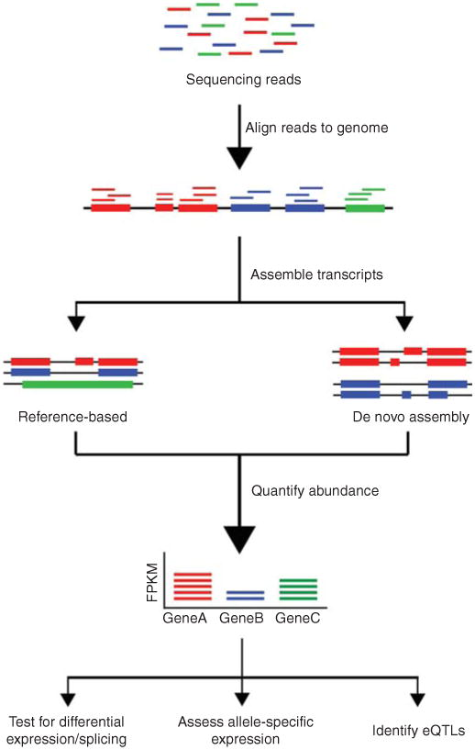

Slide 10

genome
transcriptome
proteome

Slide 11
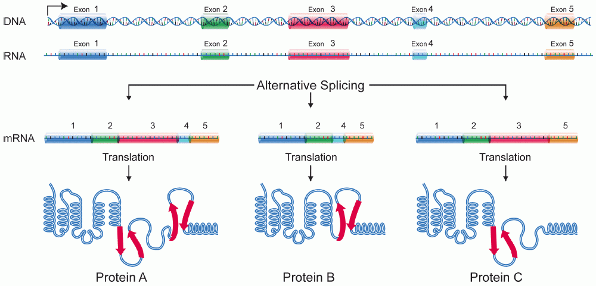
Transcription

Slide 12
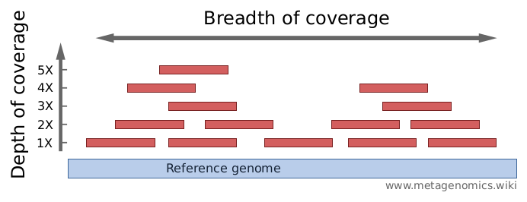

Slide 13
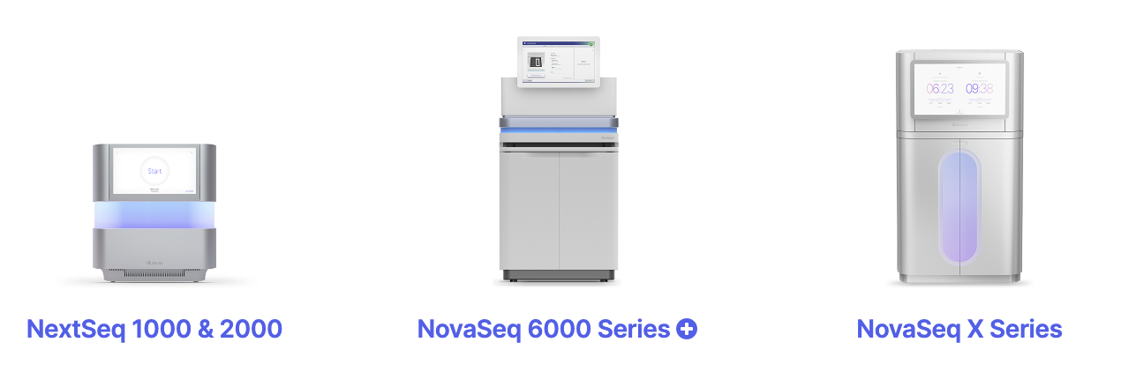
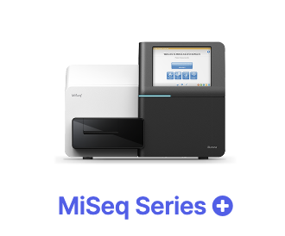
Max. output 15 Gb 360 Gb 6000 Gb 16 Tb
Max. # reads 25 M 1.2 B 20 B 52 B
Max. read length 300 bp 300 bp 250 bp 150 bp
Price per Gb $100-$200 $17-$60 $5-$30 $2-$3

Slide 14
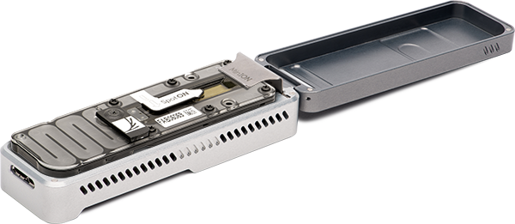
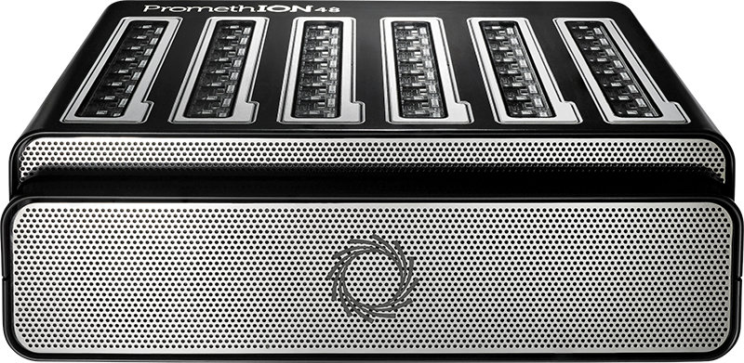
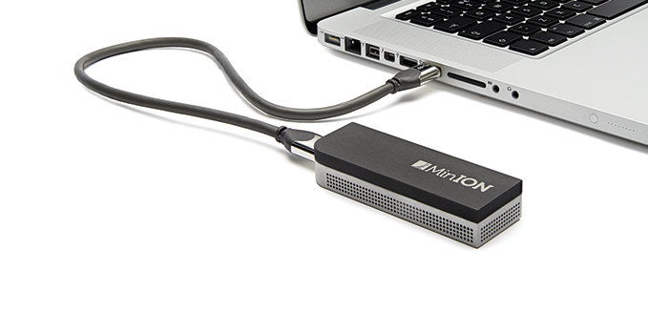
MinION ~15 Gb
PromethION ~90 Gb x 24/48 flowcells

Slide 15
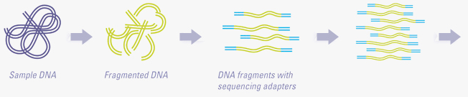
DNA fragmentation
Adapter addition
PCR enrichment
To sequencer

Slide 16
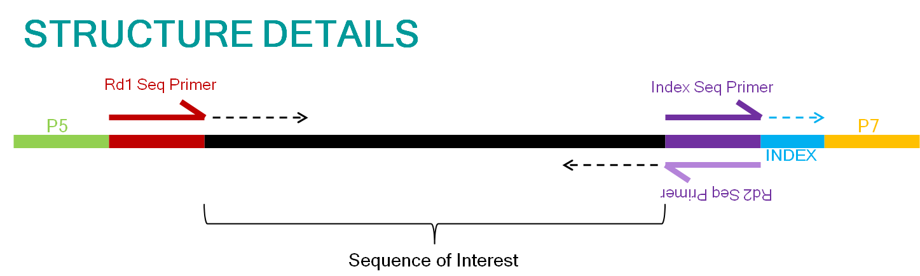
Adapter 1
DNA fragment
Adapter 2

Slide 17
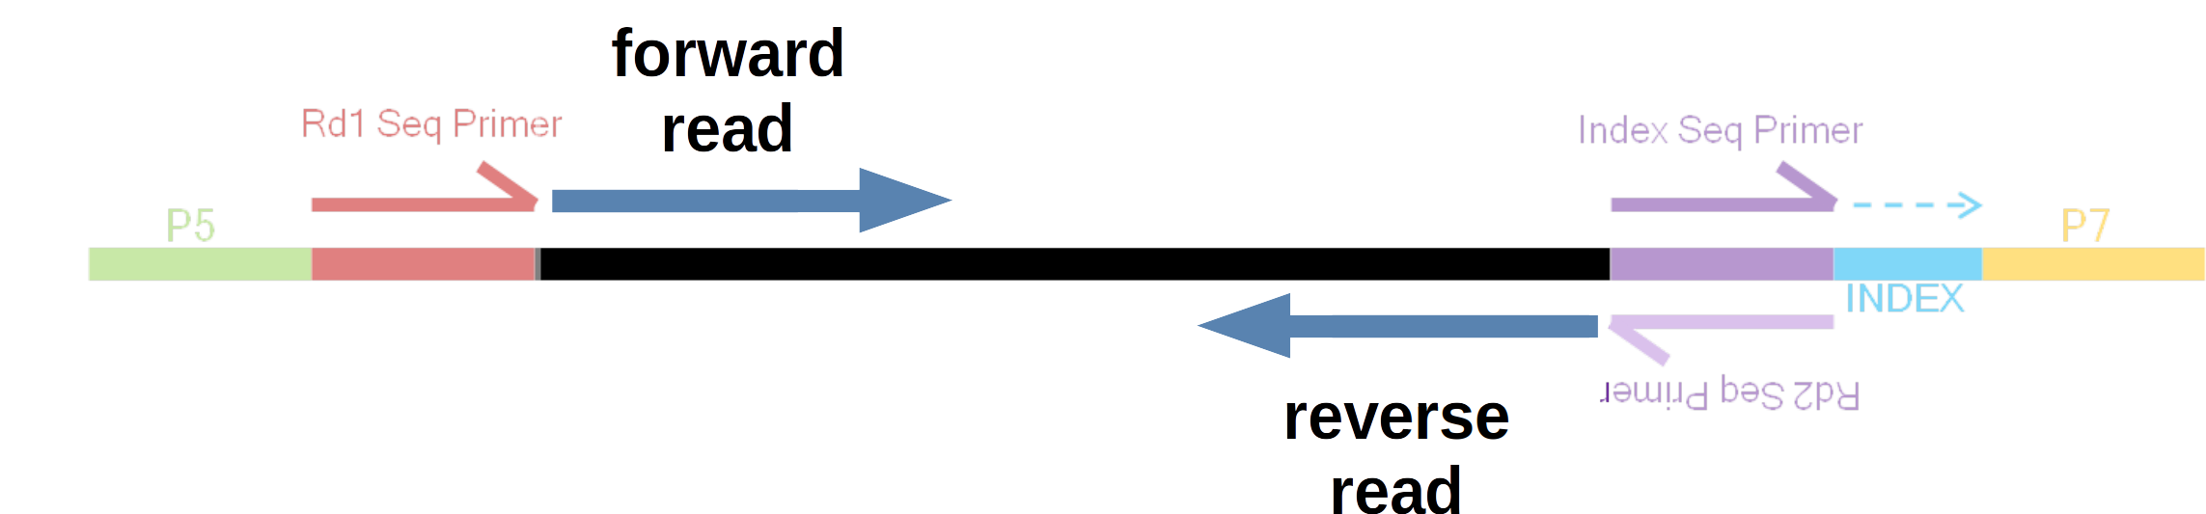
Adapter 1
DNA fragment
Adapter 2

Slide 18
forward read
reverse read
forward read
forward read
reverse read

Slide 19
forward read
reverse read
150 bp
100 bp
150 bp
Insert size: 400 bp
forward read
reverse read

Slide 20
forward read
reverse read

Slide 21
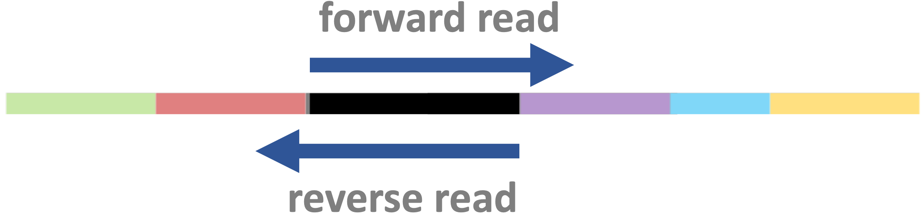


Slide 23
Indicate synthesis start site using sequencing primers
Binding to the flowcell
PCR amplification of fragments

Slide 24
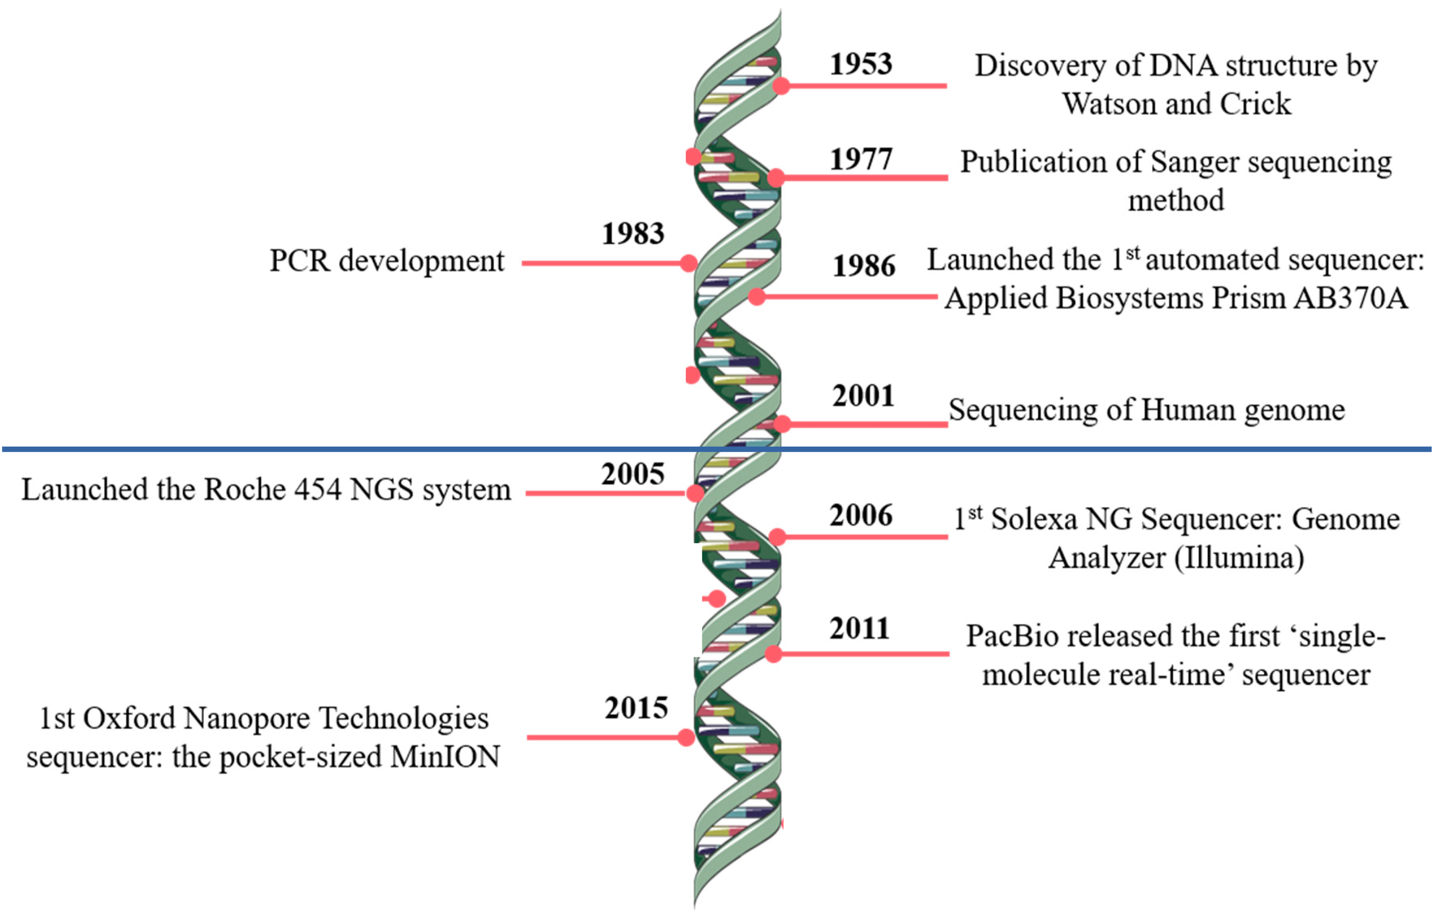

Slide 25
Indicate synthesis start site using sequencing primers
Allow for sample multiplexing using indices (barcodes)
Binding to the flowcell
PCR amplification of fragments

Slide 26
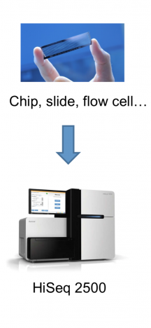

Slide 27
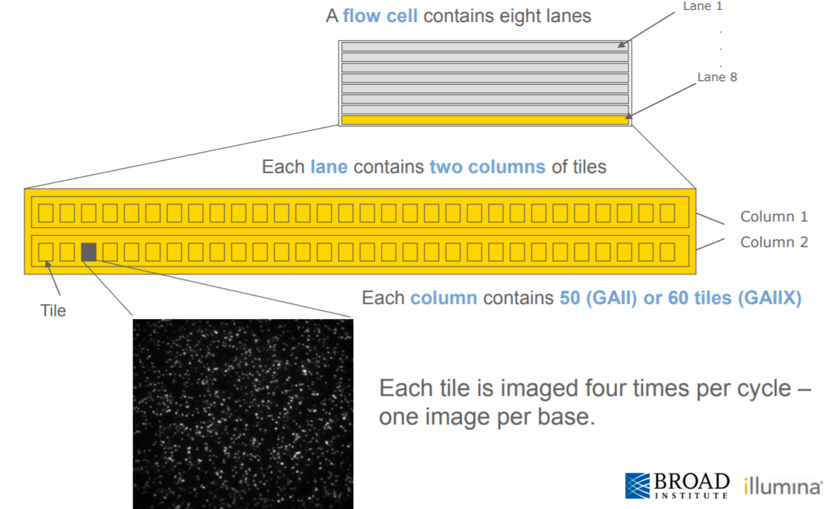
A flow cell contains multiple lanes
A lane contains multiple columns each with many tiles
Each speck in a tile is a cluster (!)

Slide 28
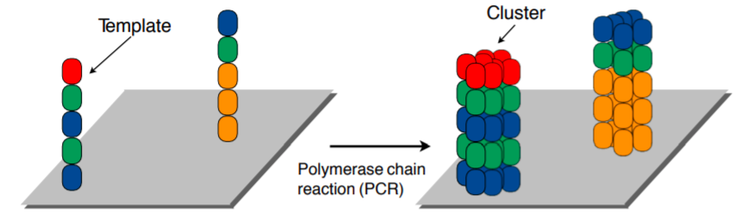
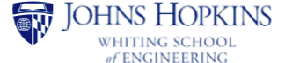

Slide 29
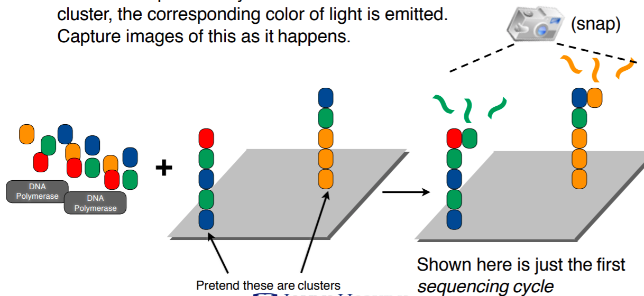
Add color-labeled nucleotides + DNA polymerase
When nucleotide is incorporated: light emitted & pictures taken

Slide 30
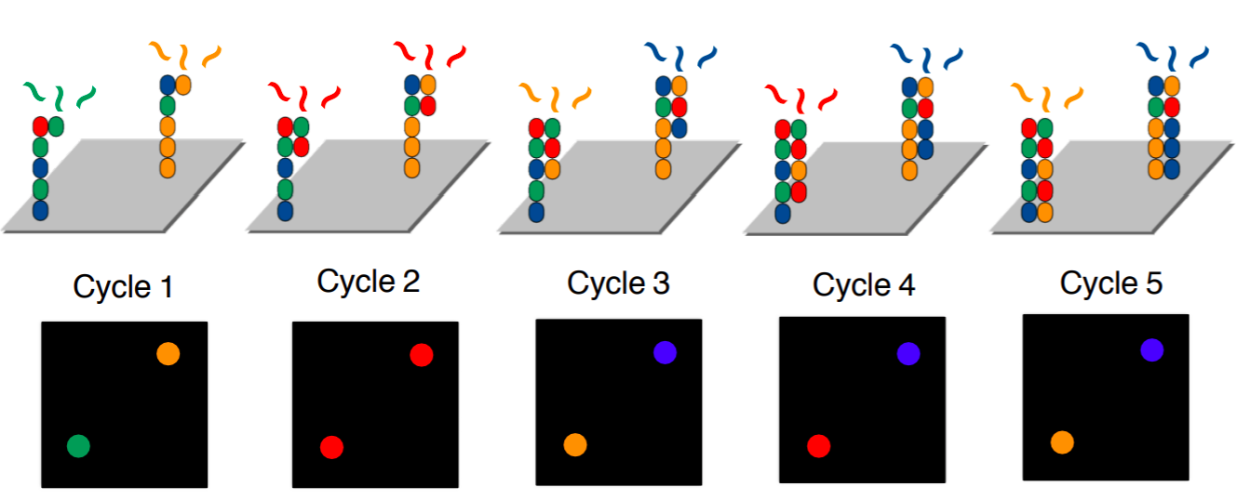
Terminators prevent continuous addition, hence “cycles”
- One cycle = one added nucleotide
- Read length = number of cycles

Slide 31
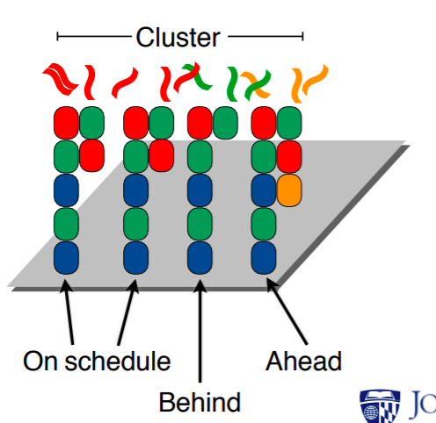

Slide 32
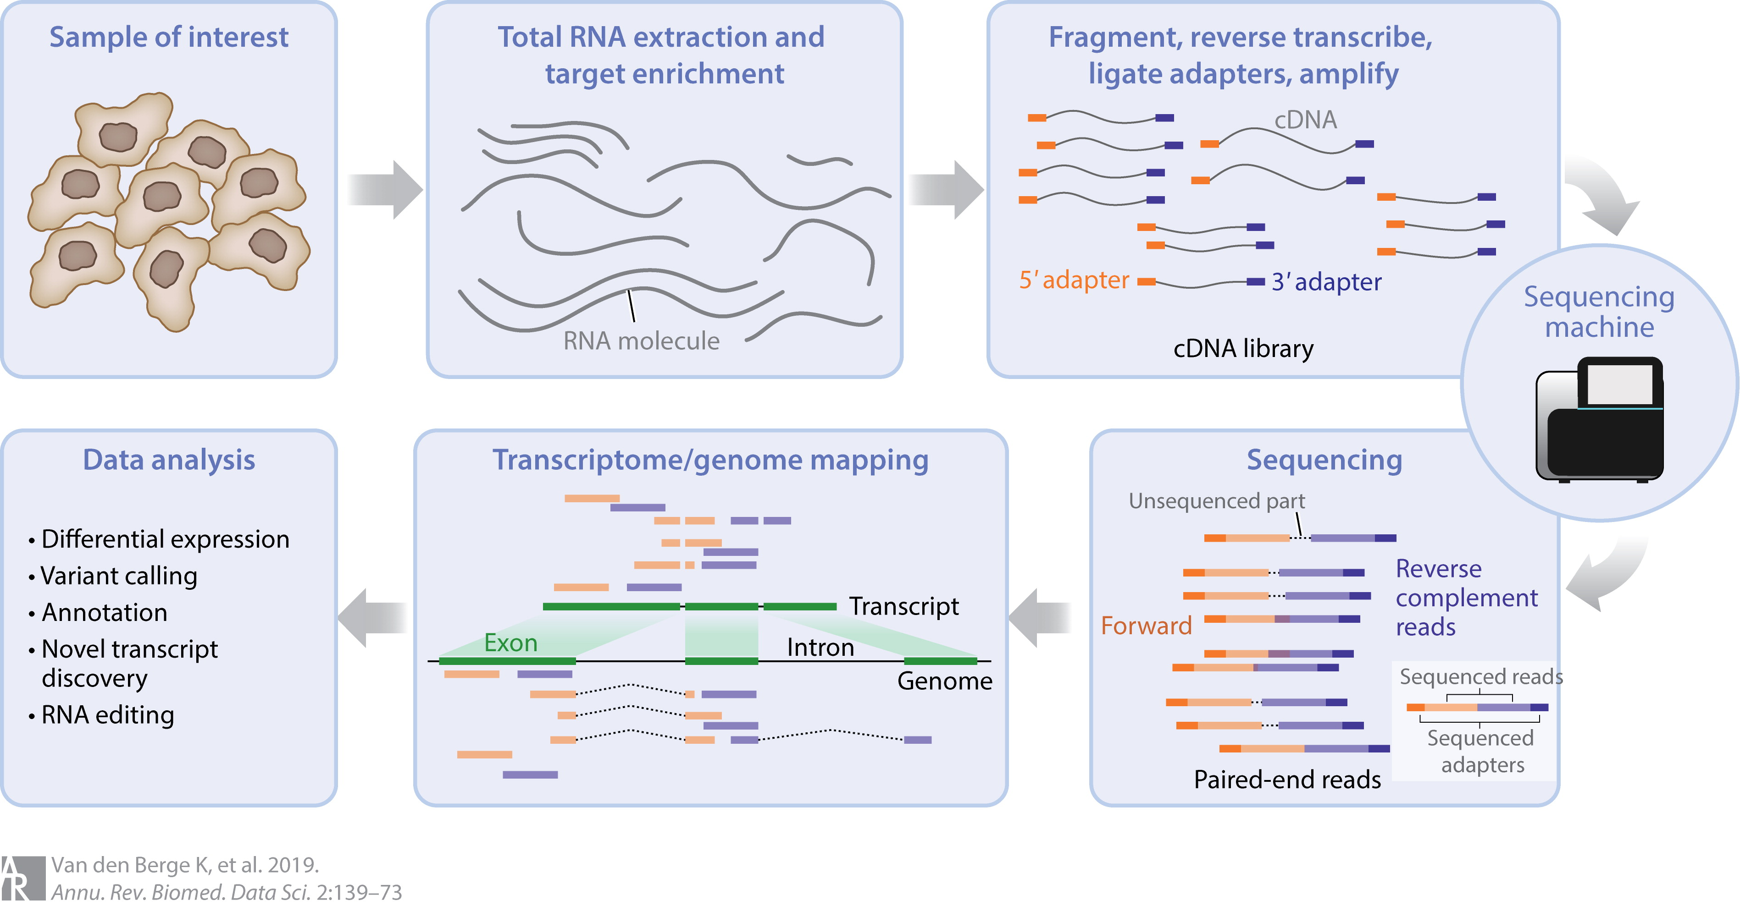

Slide 33
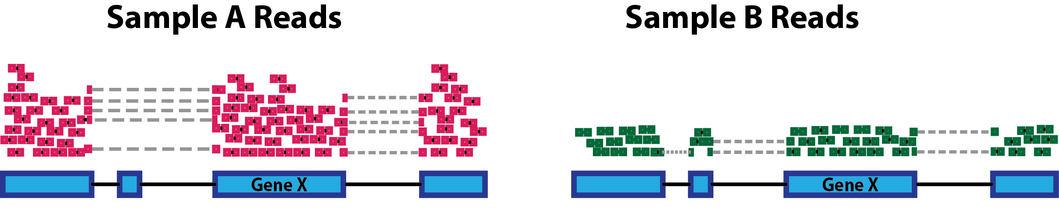

Slide 34
